Slide 1
Wildfire forecast A geospatial data science project
Sascha Moccozet, Luigi GIANETTI, Quentin Voituron

Slide 2
Why should we care ?
Wildfire has a large destructive power !
Wildfire are originally a necessary natural process for ecological succession and soil enhancement [1]BUT according to Promotheus, 8 out 10 are caused by human activities [2]
Our Focus
Prediction
Detection
Post-fire impact

Slide 3
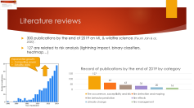

How to start ? Literature reviews and benchmark
Studies: roughly 20 years old
Satellite data are often used: often free and easily accessible
Tree-based model are among best model predictions (ironically)
Data are usually balanced 50/50 to 1/3-2/3
Our adding value: predict t+1 outcomes with initial value at time t

Slide 4
Goal
In that context we want to create a POC to help firefighters and local collectivities:
RISK map
With a model explainer to gain insight a put in place
The Are of Interest: PACA in France.
Time granulometery: one day.
Spatial resolution: 1km
Risk will be defined as: probability a specific location will be on fire. From 0 (lowest) to 1(highest)
The dataset will be balanced 50/50

Slide 5

















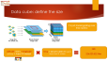





Data pipeline
Data cube building
Model building
Data providers
Raw data
raster & vector
DataFrame
Model
External provider
Remote sensoring data
Terra MODIS
Data cube
External provider
3. Merge
Reanalysis data
Deployment
Copernicus
External provider
Reanalysis data
1. Define the size
Explainable AI
Risk Map
Density dataset
External provider
Vector drawing
Personal drawing
2. Request data

Slide 6
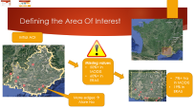
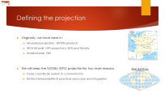




Challenges
#data = 6,102,554,094
Challenge 1: It’s a lot of data
27 features * cube size
Challenge 2: we must care of the data integrity
clipping, projection, downsampling, upsampling, regridding or interpolate… A lot of transformation will be needed
Solution: Explanatory data Analysis + features selection BEFORE merging (here)
And compare afterward

Slide 7
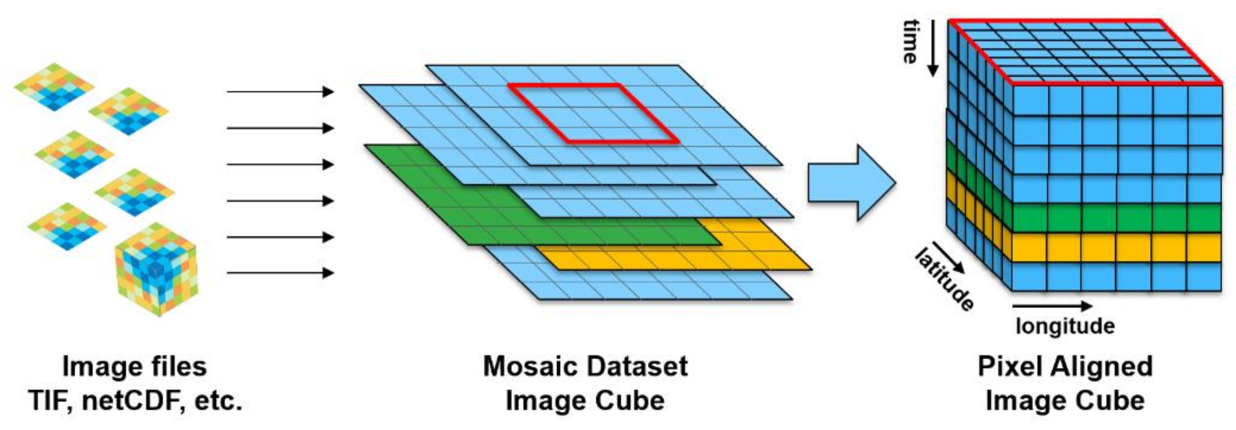
Pre-processing: dynamic variable
ET_500m
Fpar_500m
u10
v10
t2m
tp
LST_Day_1km
LST_Night_1km
_1_km_16_days_EVI
ET_500m_mean
Fpar_500m_mean
u10_mean
v10_mean
t2m_mean
tp_mean
LST_Day_1km_mean
LST_Night_1km_mean
_1_km_16_days_EVI_mean
Dynamic variables
rolling()
Dynamic variables – last
10 days mean
Notes:
Since our aim is to predict the risk of future wildfire, for any given point of the cube, we evaluate the for each feature, the previous 10 days' mean value

Slide 8
Pre-processing
 |  |  |  | density | U10_mean | … | FireMask
0 | x₀ | y₀ | time₀ | 112.735 | 0.493079 |  | 1
1 | x₀ | y₀ | time₁ | 112.735 | 0.382728 |  | 1
2 | x₀ | y₁ | time₁ | 112.735 | 0.113627 |  | 1
…
29181 | x₂₉₁₈₁ | y₂₉₁₈₁ | time₂₉₁₈₁ | 3.482 | 0.301766 |  | 0
Data cube
to_dataframe()
Multi-index, balanced
dataframe
Notes:
Since our aim is to predict the risk of future wildfire, for any given point of the cube, we evaluate the for each feature, the previous 10 days' mean value

Slide 9
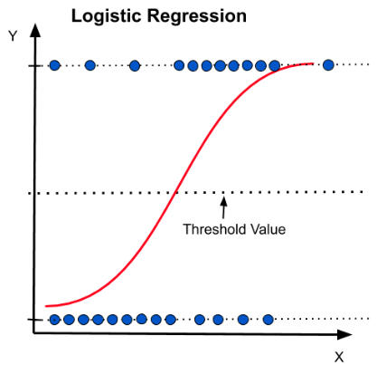
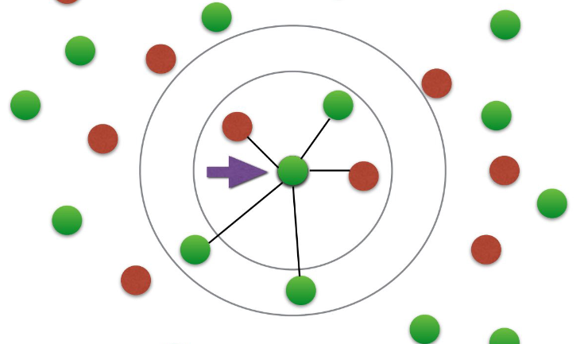
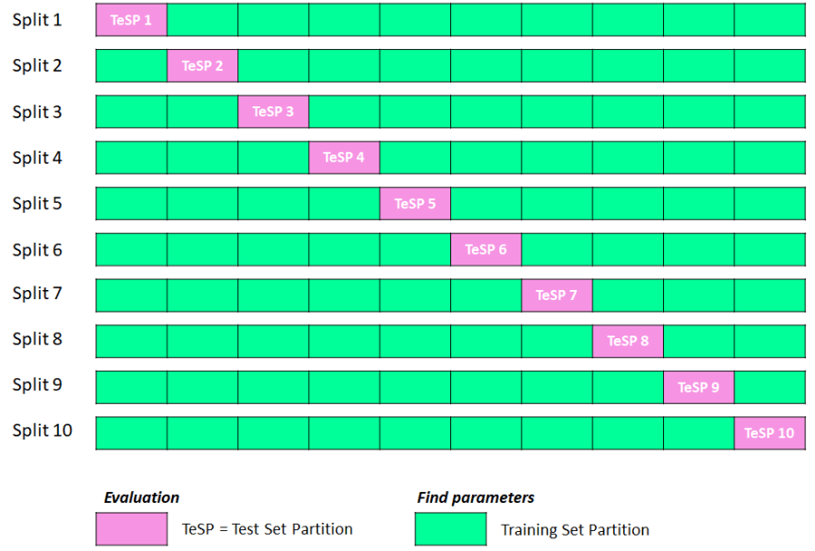
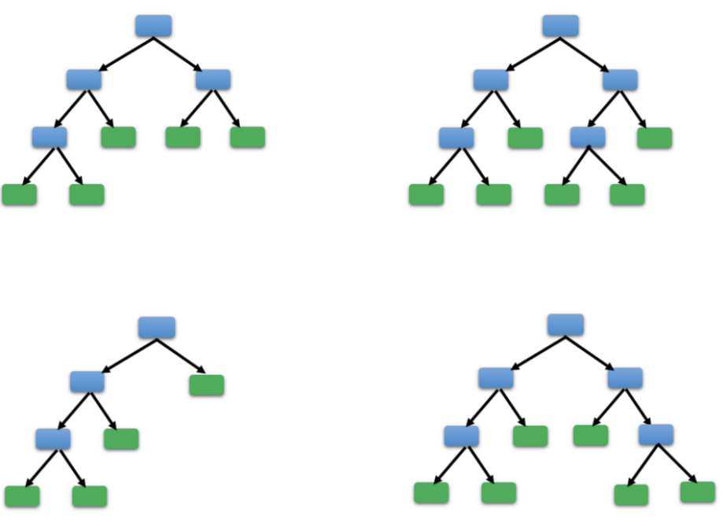
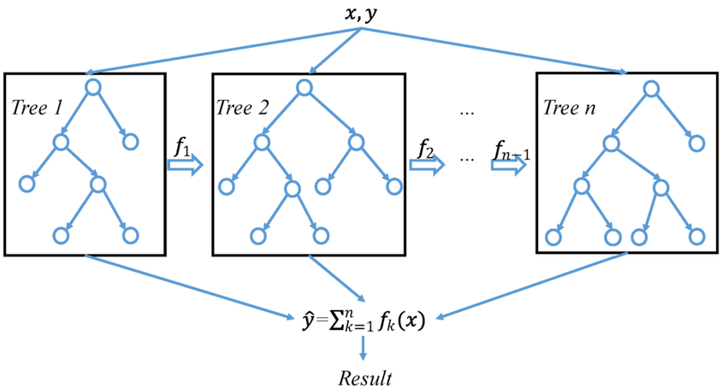
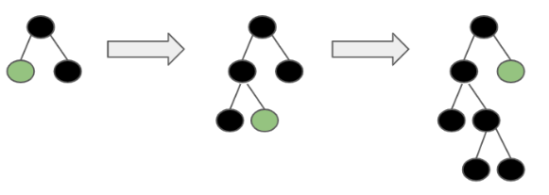
Model selction: Cross Validation
10-fold Cross Validation
Logistic regression
k-nearest neighbors
Random forest
XGBClassifier
LightGBM

Slide 10
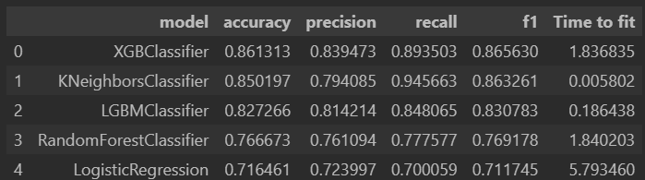
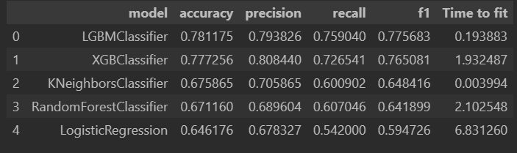
Model selction: Cross Validation
Shuffled
Better results if shuffled
Best shuffled model: XGBClassifier
Best unshuffled model: LightGBM
Best quality/effort in both: LightGBM
Real case configuration best suits a non-shuffled model
Non-shuffled

Slide 11
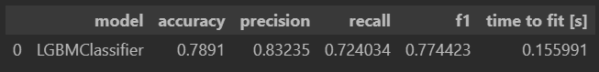
Fitting and tuning the LightGBM model
Split the data:
2013 to 2017 train set
2018 to 2020 test set
Evaluate the metrics indicators over the test set
Model
Dataframe
Fit the LightGBM model over the train set
Tune hyperparameters

Slide 12




ExplainerDashboard Deployement
LoadFiles.py
AWS EC2 instance
Copy file on AWS EC2 instance
Docker container
Upload files from github to AWS EC2 instance
DataFrame
Model
Docker files
Dashboard.py

Slide 13
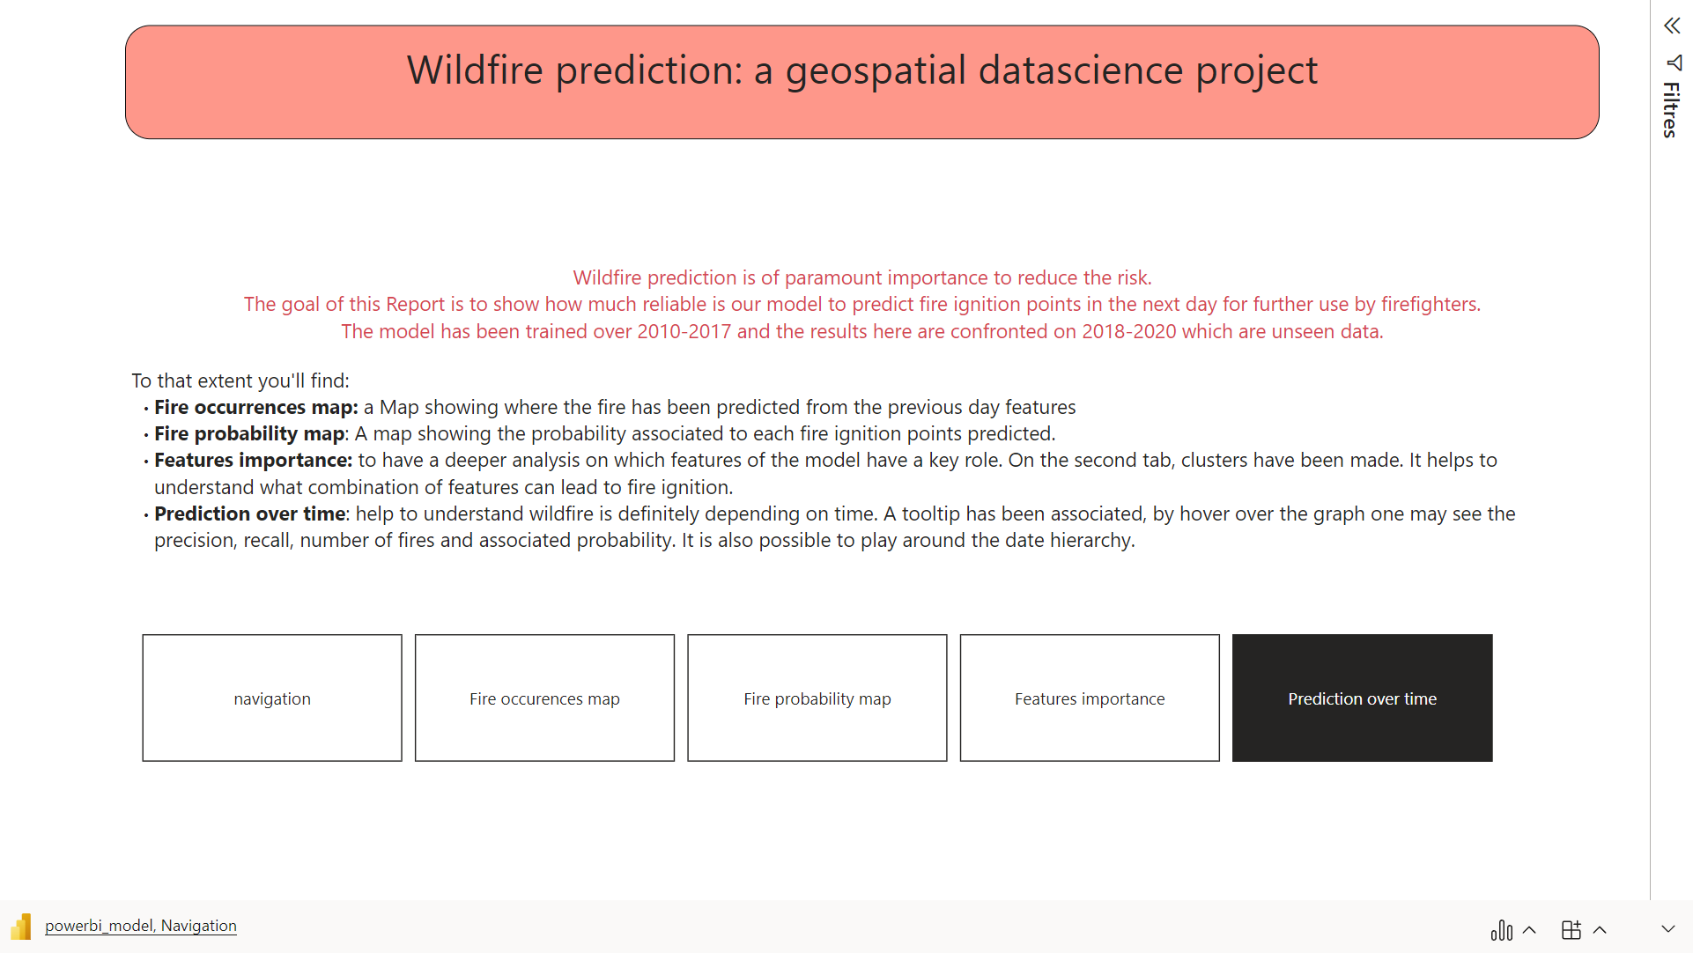

Slide 14
Conclusion
Wildfire can be predicted by ML model
To go further:
Extension from 1 day to one week
Automatize end-to-end
Time series analysis
Develop a model based on time + space patches
Simulation (Monte-Carlo ?) to predict risk on a longer time basis

Slide 15
Index slide: natural and anthrologic causes
Wildfire are originally a necessary natural process for ecological succession and soil enhancement [1]
BUT according to Promotheus, 8 out 10 are caused by human activities [2]
Both natural conditions and human activities can enhance ignition risk and propagation, to site a few: [2]
Natural
Weather conditions (wind, rain, thunder…)
Soil moisture
Anthropologic
Accident (train, power-line…)
Malicious conduct
Vegetation types
Orographic conditions (flat, steep…)
Negligence (cigarette butt, bbq…)
Forest & farming
Urban sprawl

Slide 16

Litterature reviews
First risk mapping in 2006 (Piyush Jain & al., 2020). They used CART. Nowadays, ANN and RF are commonly used and give good results compare to linear models. (Goldarag et al. 2016, Oliveira et al. 2012)
When supervised ML, original datasets are highly imbalanced (fire/no fire) and there is no standard along the papers. If no correction, precision and F1 score are close to 0.
Often, models are evaluated on a test/evaluation set. It is interesting from a ML point of view. But for real life application we will use past and present data to predict fire occurrence without any knowledge of some parameters at t+1. (Ioannis Prapas et al. 2021, Fantine Huot et al. 2022)

Slide 17
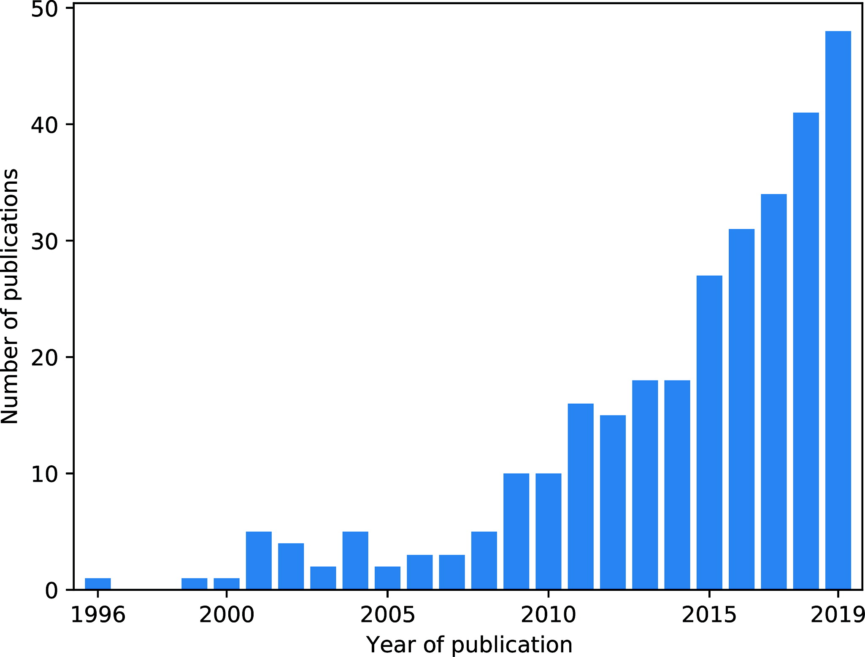


Literature reviews
300 publications by the end of 2019 on ML & wildfire science (Piyush Jain & al., 2020) .
127 are related to risk analysis (lightning impact, binary classifiers, heatmap…)
Exponential growth:
Computing power
Satellite data

Slide 18

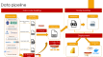


Data cube: define the size
It is just stacking/piling over time rasters!
SIZE
226,020,522 tiles
Latitude(182km) * longitude (309 km) = Area Of Interest
Time = 2010/01-2021/01 (4019 days) from Lit. review

Slide 19


Collect data
Data providers
10 datasets
Raw data
raster & vector
External provider
Vegetation (MOD13A2 v061)
Land surface temperature (MOD11A1)
Leaf Area Index (MOD15A2H v061)
Evapotranspiration (MOD16A2 v061)
Burn date (MCD64A1 v061)
Fire Mask (MYD14A2)
Remote sensoring data
CONCLUSION
10 datasets
27 layers (features)
3 files formats
EU vs USA std. : projection, time calendar…
resolution: 500m, 1km, 9 km
Different time granulometry: hrs, days, 8, days, month
Terra MODIS
External provider
Reanalysis data
Population density
Density dataset
External provider
Reanalysis data
Meteorological data (ERA5-Land)
Fire Weather index
Copernicus
External provider
Area Of Interest
Vector drawing
Personal drawing

Slide 20


Datacube creation: python script flow
11 Create aggregated variables
Deleting duplicates attributes
Resampling to daily
Load the raw datasets
Select variables of interest
Select duration
Subset the time slice 2010-2021
Write CRS
Create CRS for sinusoidal projection, rotated pole and WGS84
Set the CRS for each dataset
Clipping
Define the Aoi
Clip to the AOI
Projection
Define a common grid
Project to the same CRS as the common grid
Project to the common grid
Create two lists
Merging
Fill the missing values
Harmonize the CF time convention to “Julian”
Subset the time slice 2010-2021
Match the coordinates
Rename the coordinates
Merge
Notes:
Snippet de code à ajouter

Slide 21
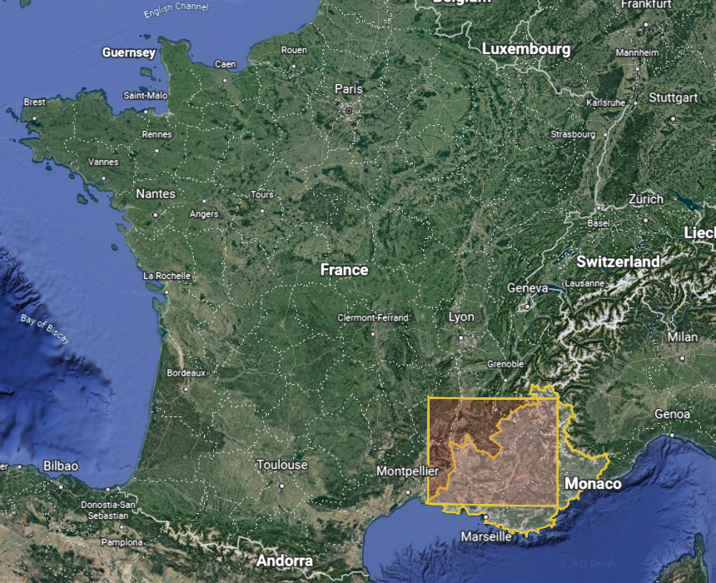

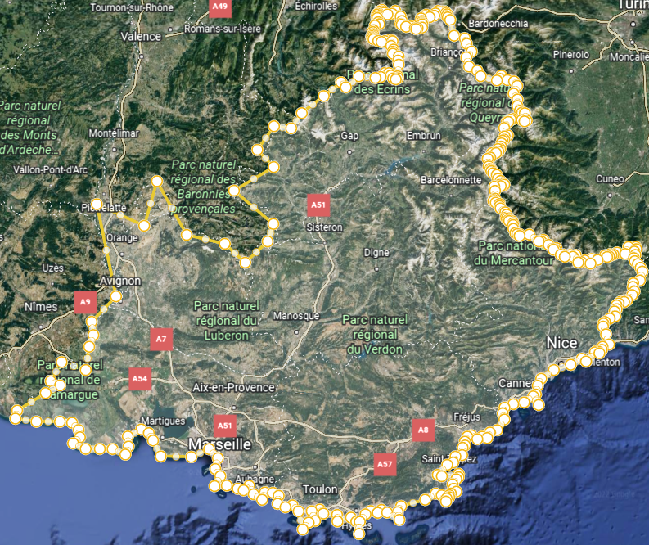
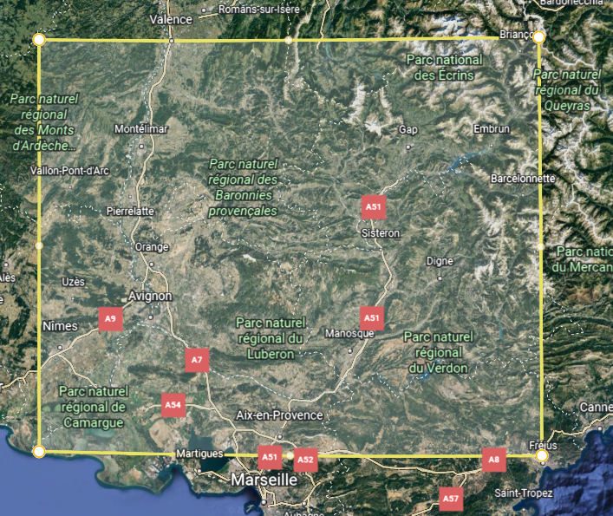




Defining the Area Of Interest
Initial AOI
Missing values
50%+ in MODIS
60%+ in ERA5
7%+ Na in MODIS
19% in ERA5
More edges → More Na

Slide 22
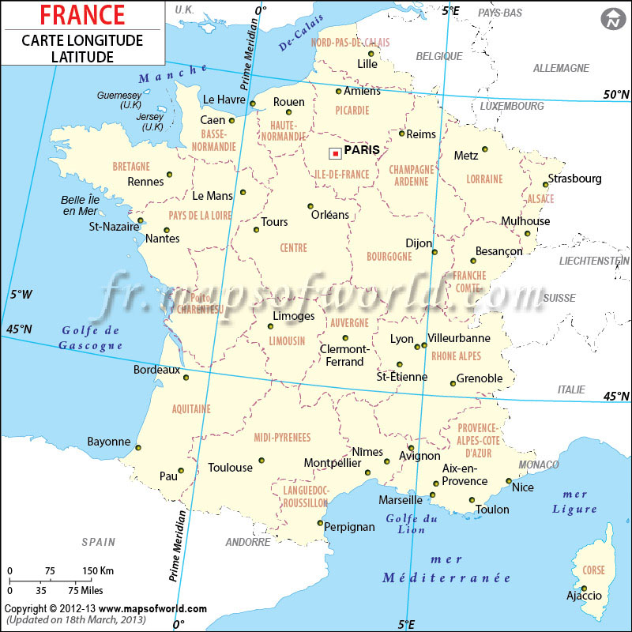
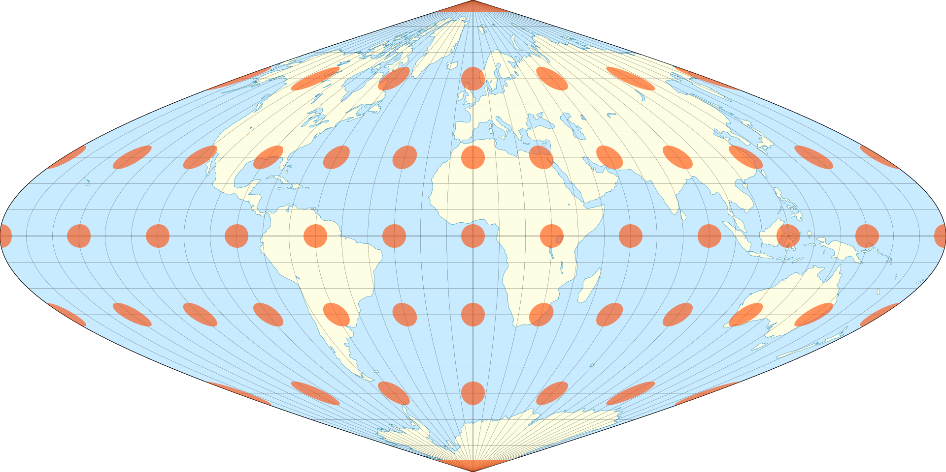


Defining the projection
Originally, we have data in:
Sinusoidal projection : MODIS products
WGS 84 (ndlr: GPS projection): ERA and Density
Rotated pole: FWI
We will keep the WGS84 (GPS) projectionfor two main reasons
Easier coordinate system to communicate
Better interoperability fir practical used case and integration
SINUSOIDAL

Slide 23
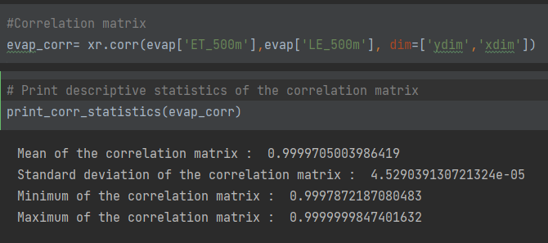


Features selection
High correlation between variables (same spatial location over time)
Interpretability:
Quality data in bit signed were not useful four our study in the latest MODIS product (reanalysis)
Here the evapotranspiration “ET_500m” and the latent heat “LE_500m” flux are strongly correlated

Slide 24
References
Piyush Jain piyush.jain@canada.ca, Sean C.P. Coogan, Sriram Ganapathi Subramanian, Mark Crowley, Steve Taylor, and Mike D. Flannigan, 2000. A review of machine learning applications in wildfire science and management
Nadeem K., Taylor S.W., Woolford D.G., and Dean C.B. 2020. Mesoscale spatiotemporal predictive models of daily human- and lightning-caused wildland fire occurrence in British Columbia. Int. J. Wildl. Fire, 29(1): 11–27.
Vega-Garcia C., Lee B.S., Woodard P.M., and Titus S.J. 1996. Applying neural network technology to human-caused wildfire occurrence prediction. AI Appl. 10: 9–18. Available from https://cfs.nrcan.gc.ca/publications?id=18949.
Goldarag Y.J., Mohammadzadeh A., and Ardakani A.S. 2016. Fire Risk Assessment Using Neural Network and Logistic Regression. J. Ind. Soc. Remote Sens. 44(6): 885–894.
Oliveira S., Oehler F., San-Miguel-Ayanz J., Camia A., and Pereira J.M. 2012. Modeling spatial patterns of fire occurrence in Mediterranean Europe using Multiple Regression and Random Forest. For. Ecol. Manage. 275: 117–129.
Fantine Huot1 , R. Lily Hu2 , Nita Goyal, Tharun Sankar, Matthias Ihme, and Yi-Fan Chen. 2022. Next Day Wildfire Spread: A Machine Learning Data Set to Predict Wildfire Spreading from Remote-Sensing Data. Available from https://arxiv.org/pdf/2112.02447.pdf
Ioannis Prapas1,2,*, Spyros Kondylatos1,2,*, Ioannis Papoutsis1 , Gustau Camps-Valls2 , Michele Ronco2 , Miguel-Ángel Fernández-Torres2 , Maria Piles Guillem2 , and Nuno Carvalhais3. 2021. Deep Learning Methods for Daily Wildfire Danger Forecasting. Available from https://arxiv.org/pdf/2111.02736.pdf

Slide 25
Reference
Causes
Data source
[1] Earth Data from NASA
[2] Ministère de lécologie et du développement durable
Era:
era 5
What is reanalisis

Slide 26
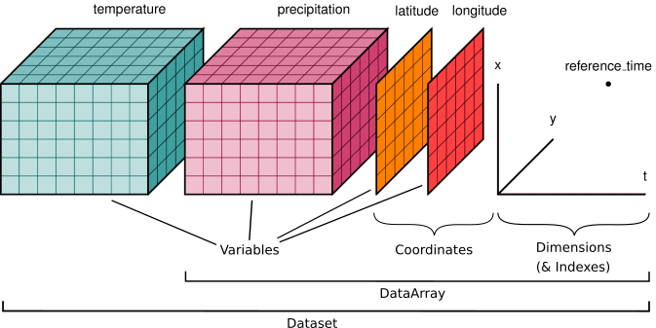
Manipulating

